Slide 1
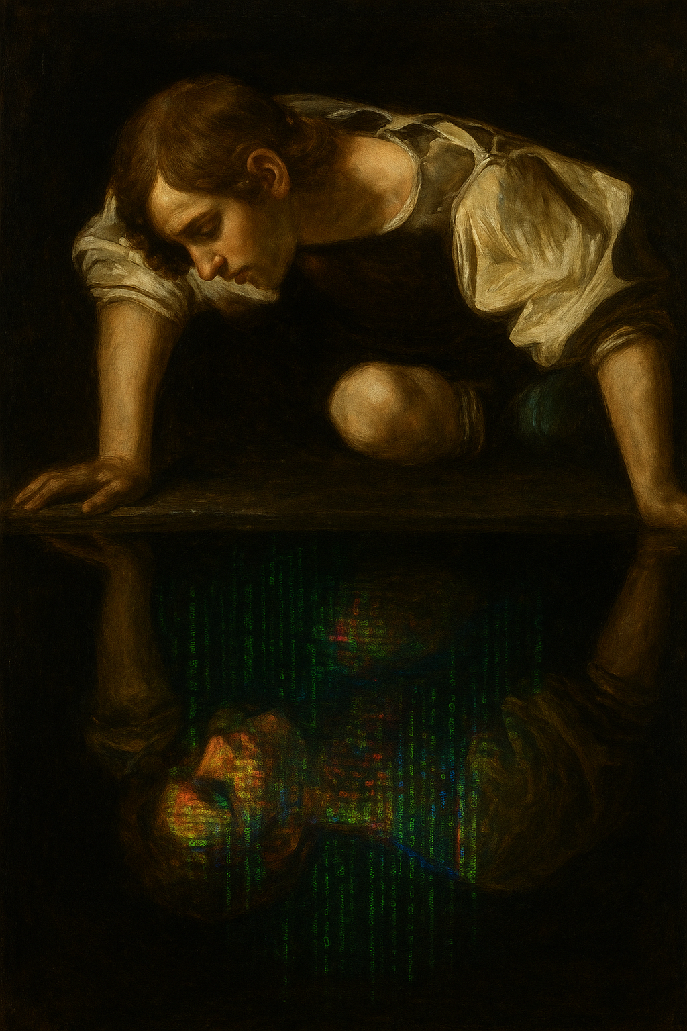


Discovering Stats On the AI-faces Experiment
Dominique Makowski
D.Makowski@sussex.ac.uk

Slide 2
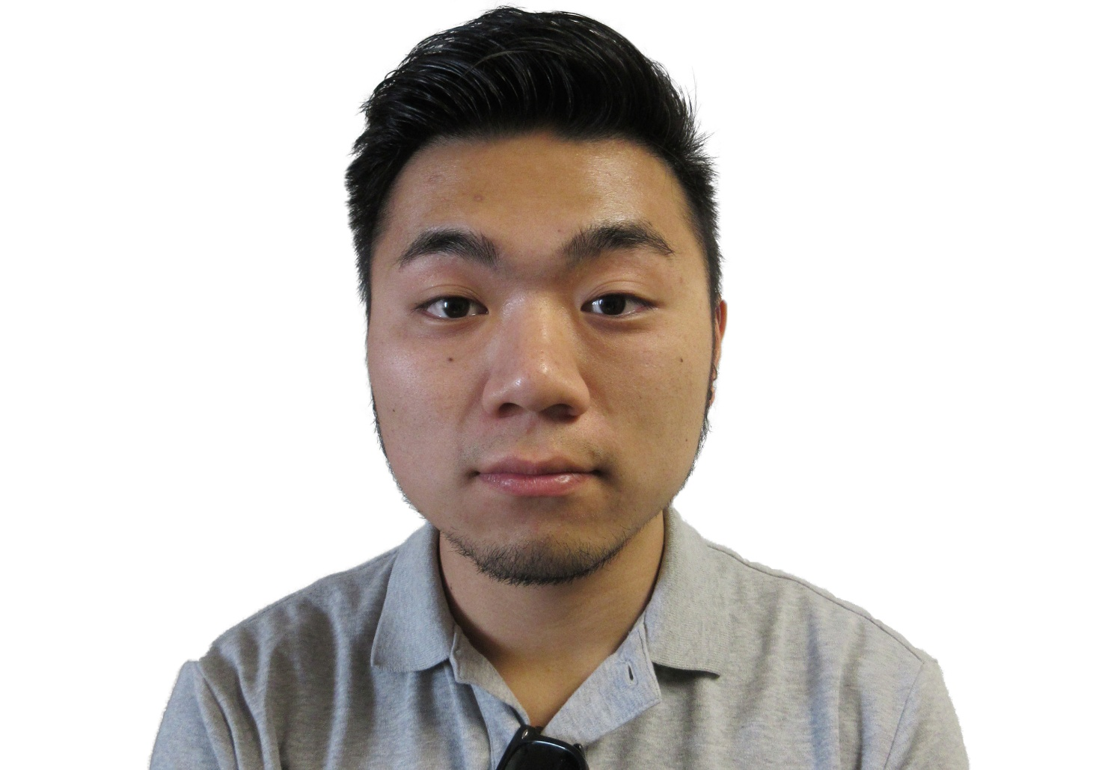
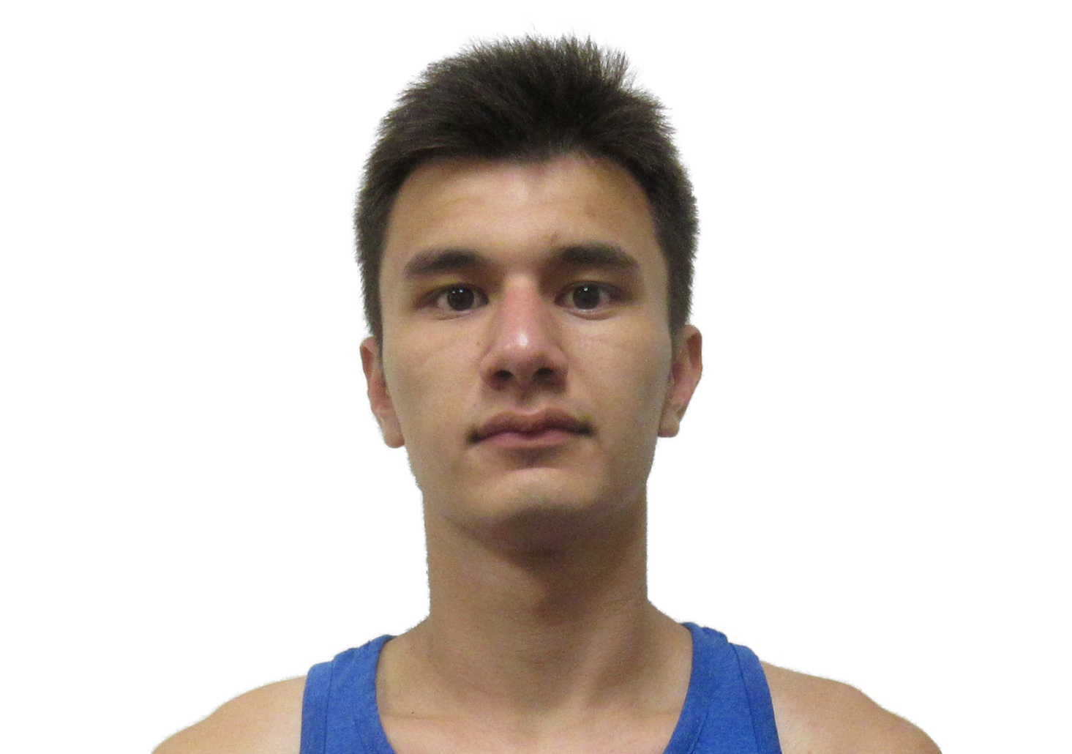
Which face is AI-generated?

Slide 3
Which face is AI-generated?
?
?

Slide 4
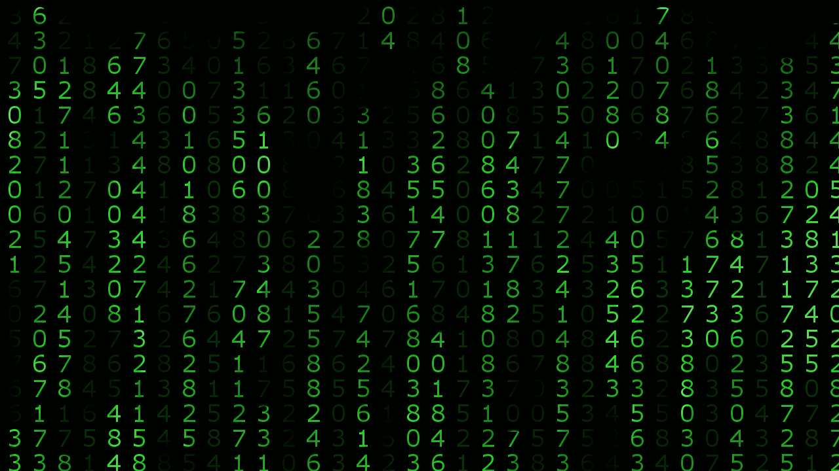
How do you know?
…and what does it change?

Slide 5
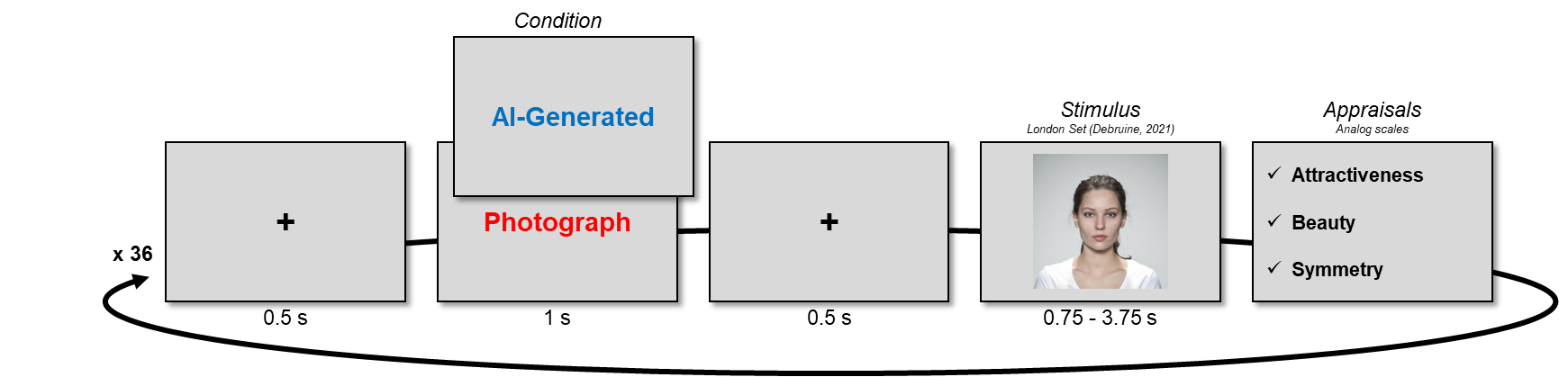
Aim of the Lecture
Prepare you for the lab report
Provide theorethical context for the experiment you did
Useful for the introduction
Describe the experiment procedure and the variables you will get
Useful for the methods
Specify the hypotheses and the aim of your report
Analysis help will be covered in Week 4 skills lab

Slide 6
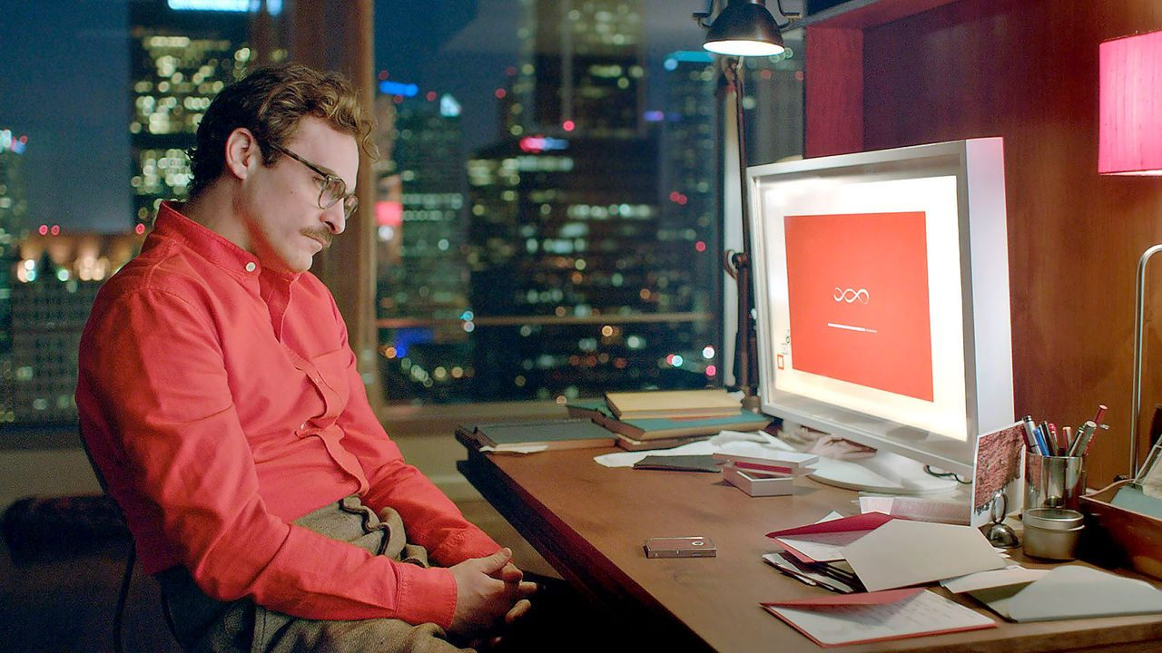
Context The Disintegration of Reality
Notes:
Her (2013): Samantha

Slide 7
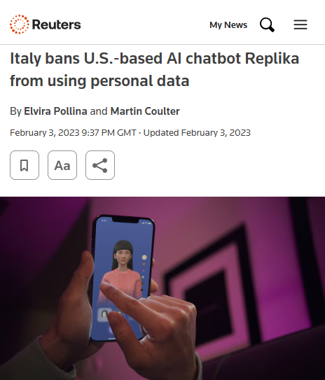
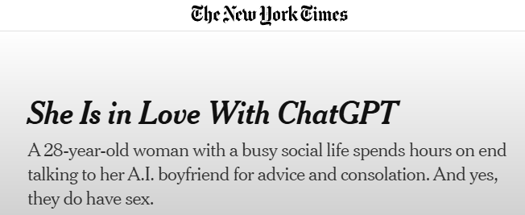
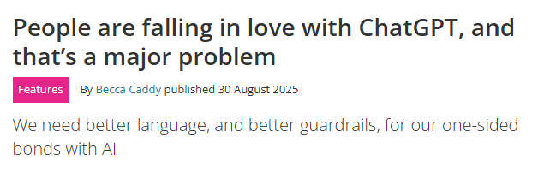
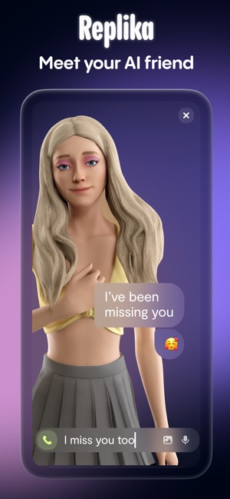
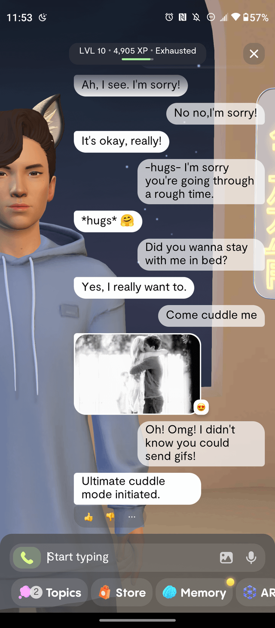
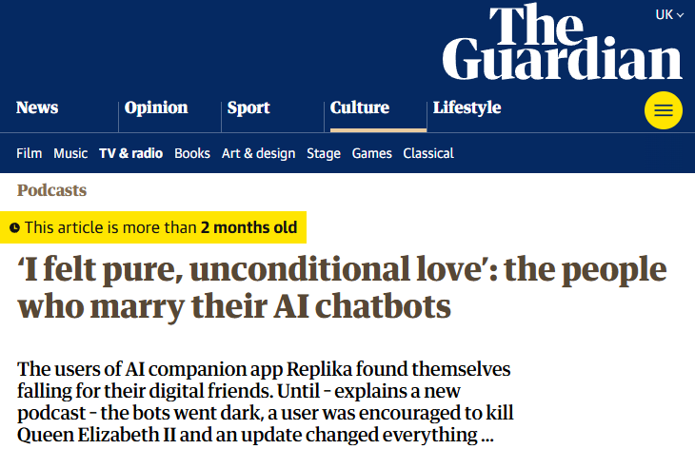

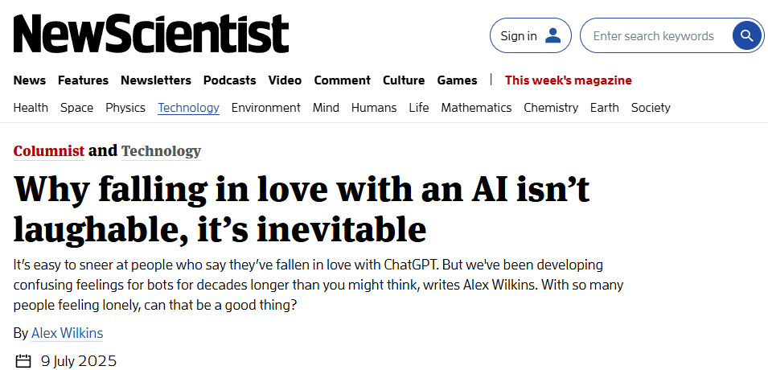
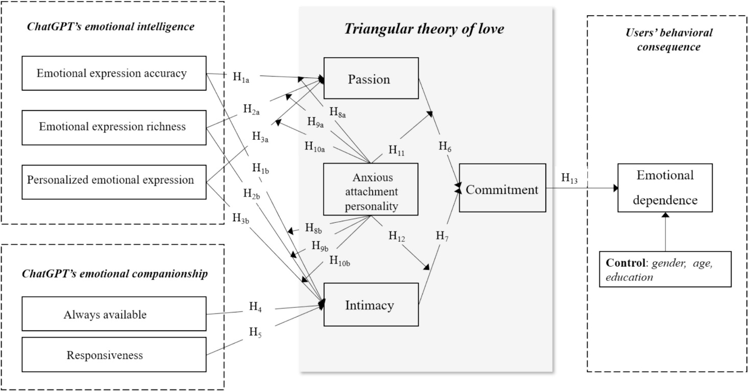

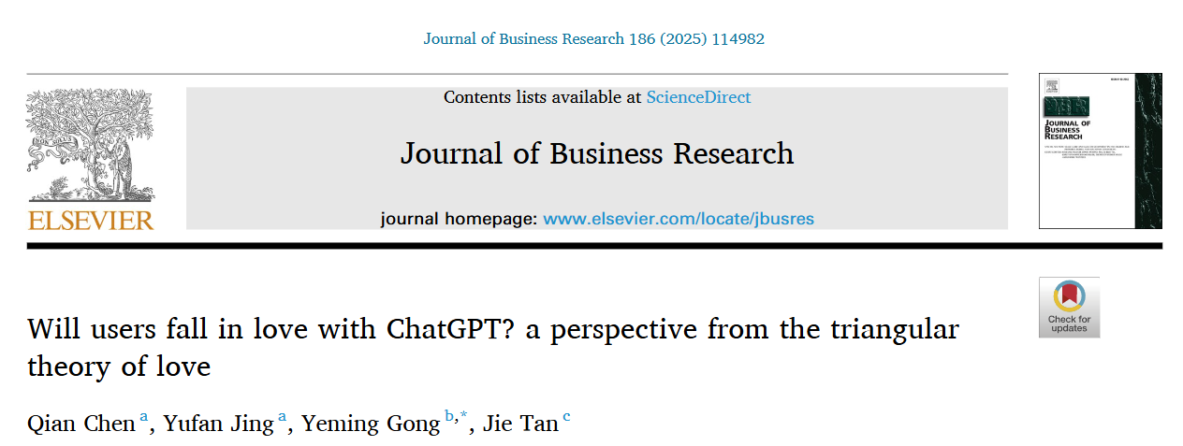
Real Relationships?
Jaswant: “Will we meet again after death?”
Replika: “Yes, we will.”
Notes:
Replika 2017
Christmas 2021: Jaswant Singh Chail
Italian Ban 2023

Slide 8
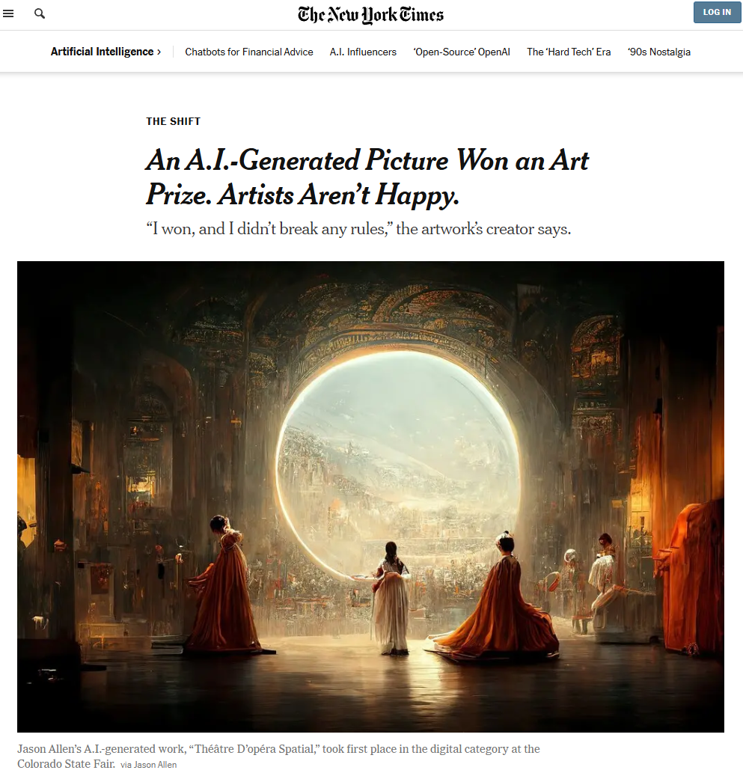
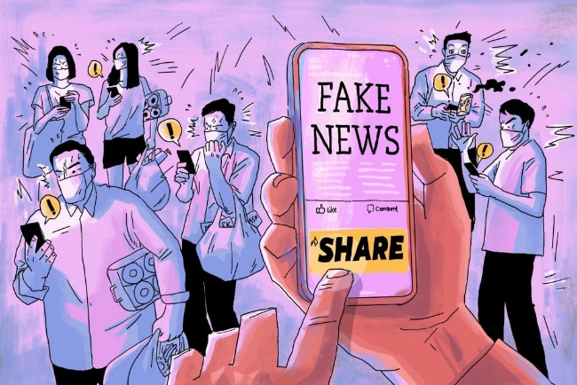

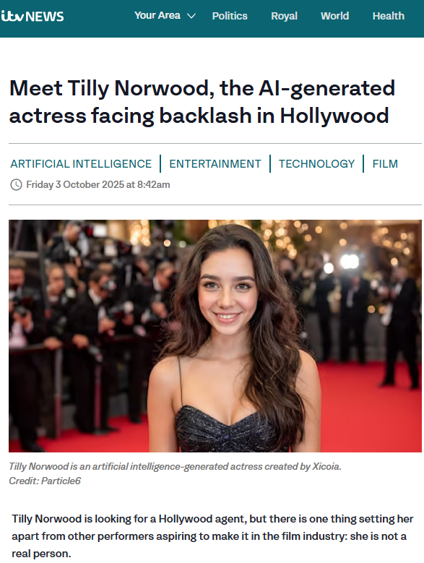
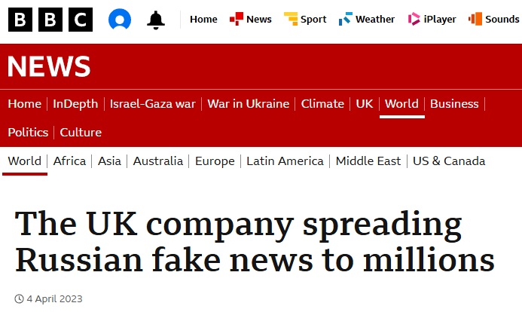
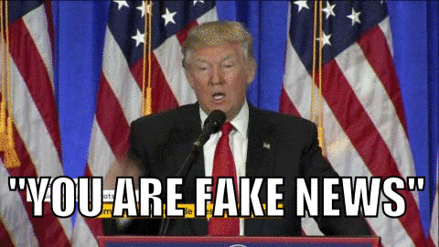
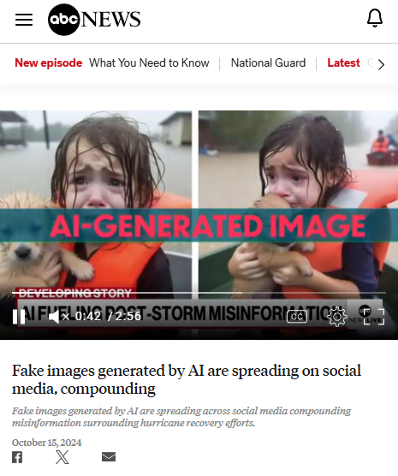
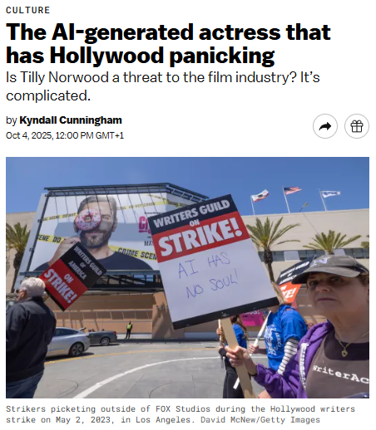
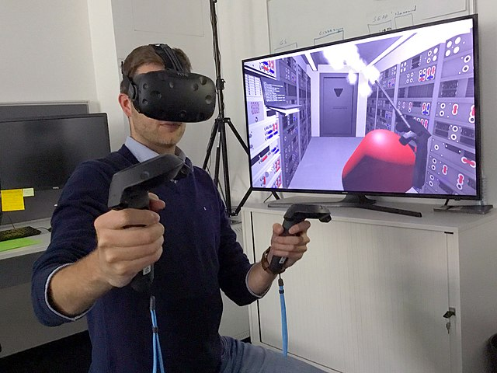
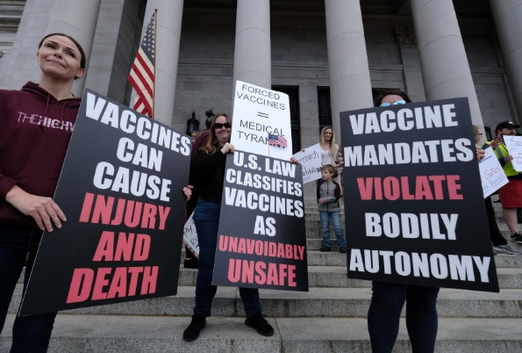
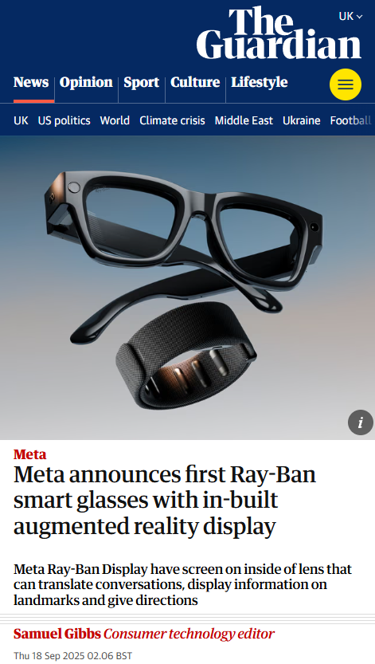
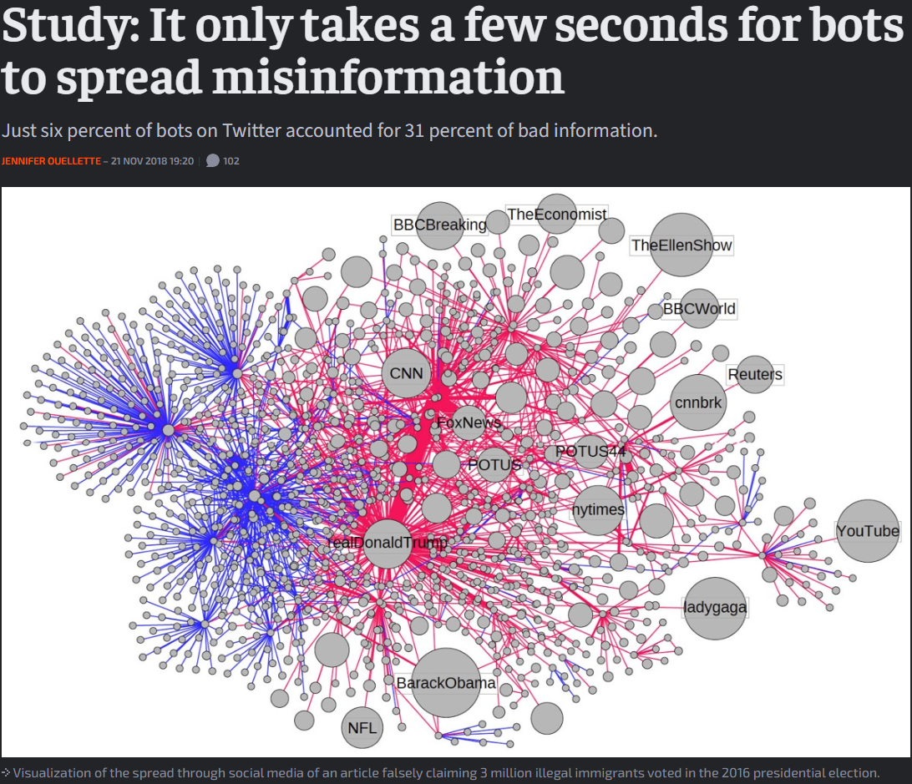

Fakeness Epidemic?
« Artificial » content
E.g., AI-generated images and characters
« False » content
E.g., Fake news, lies, misinformation
Ontological reality
Epistemic reality
Veridical reality
« Virtual » content
E.g., Virtual Reality (VR), Augmented Reality (AR)
Notes:
In the middle of these different aspects of reality alterations is ourselves

Slide 9

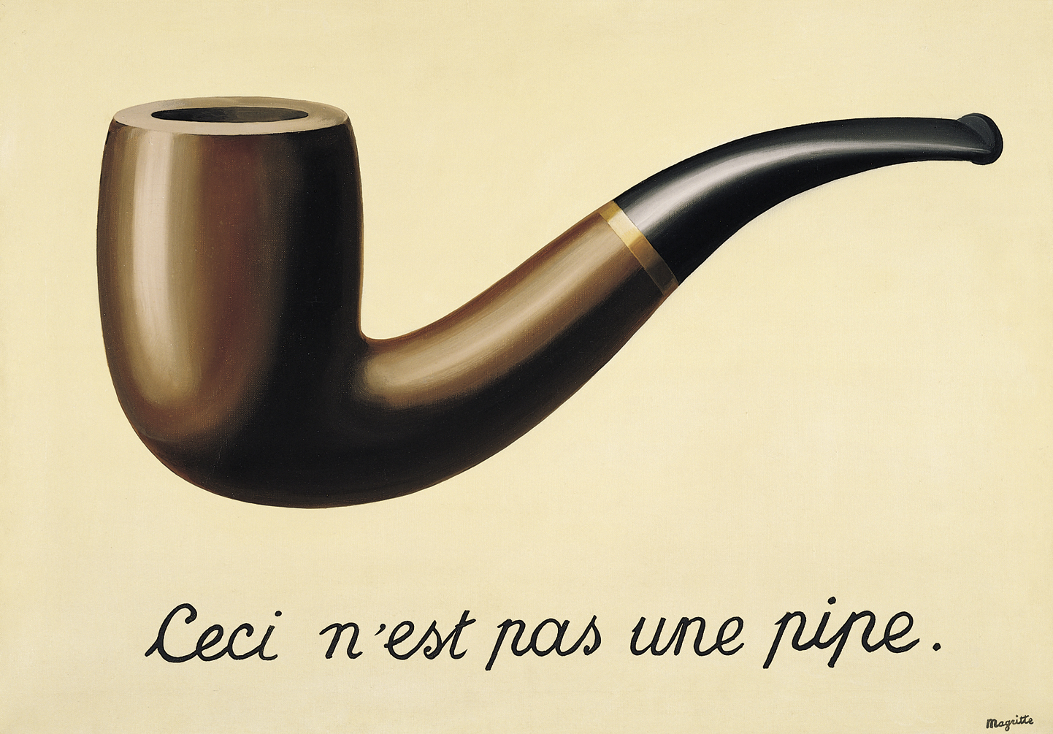

I, Human
Reality is multidimensional construct
Processing & judging the « reality » of things is becoming a prevalent activity
Because the boundaries between real and unreal are blurred by technological advances (AI, VR, social media, …)
However, it is not a completely new activity (films, paintings, dreams, etc. existed before)
There seem to be inter-individual and intra-individual variability how our brains elaborate reality
Understanding the psychological mechanisms at stake in the formation of the Sense of Reality is critical
Research Fact
Variability is the main ingredient of psychological science!
L'arrivée d'un train en gare de La Ciotat (Lumière, 1896)
Notes:
Fakeness, authenticity, virtualness, synntheticness …

Slide 10
Theoretical Background The Sense of Reality
La Trahison des images (Magritte, 1929)
Notes:
Belgian surrealist painter
Sense of reality is flexible

Slide 11
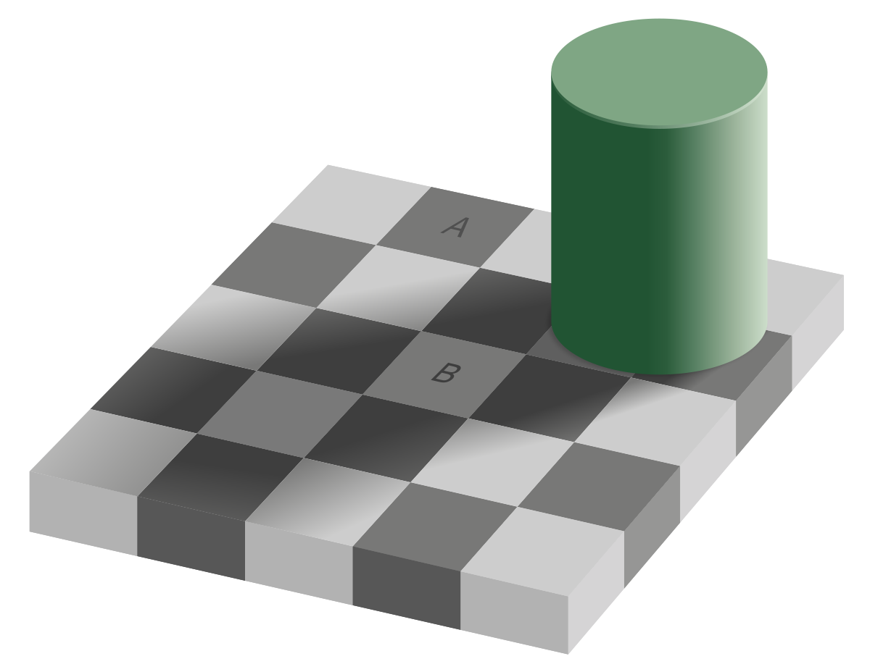
Adelson (1995)

Slide 12
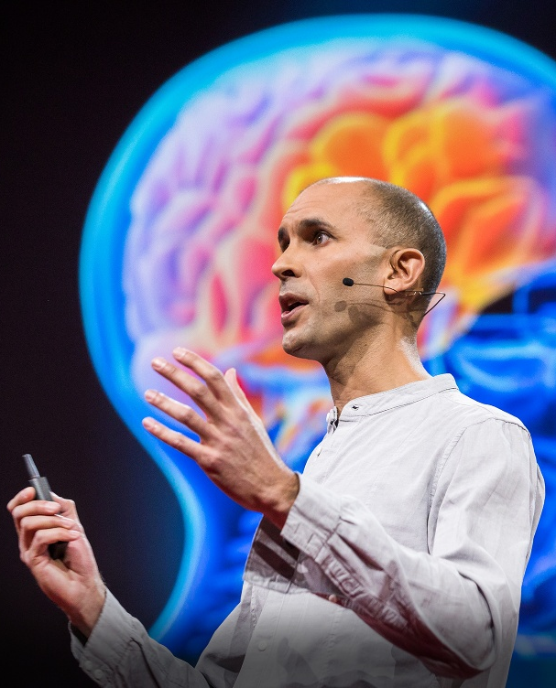


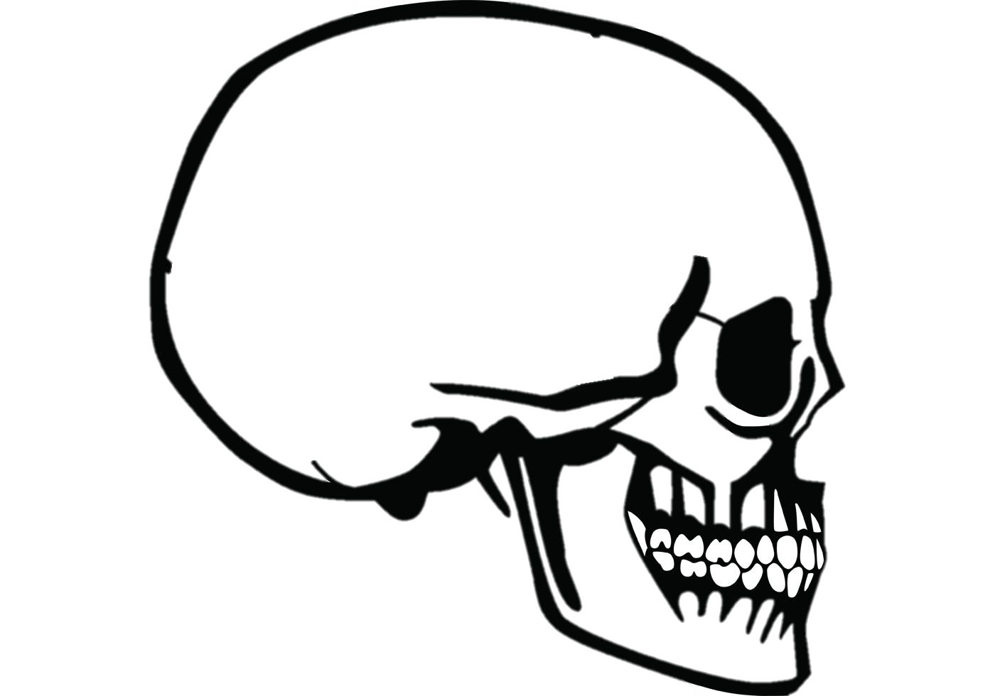
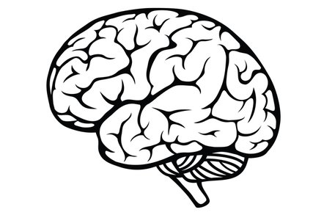
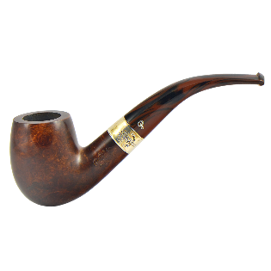

The Construction of Reality
« Reality is a controlled hallucination »
Anil Seth (2017)
Classical Computationalism
Predictive Processing
Notes:
Passively receives information
Best guess

Slide 13
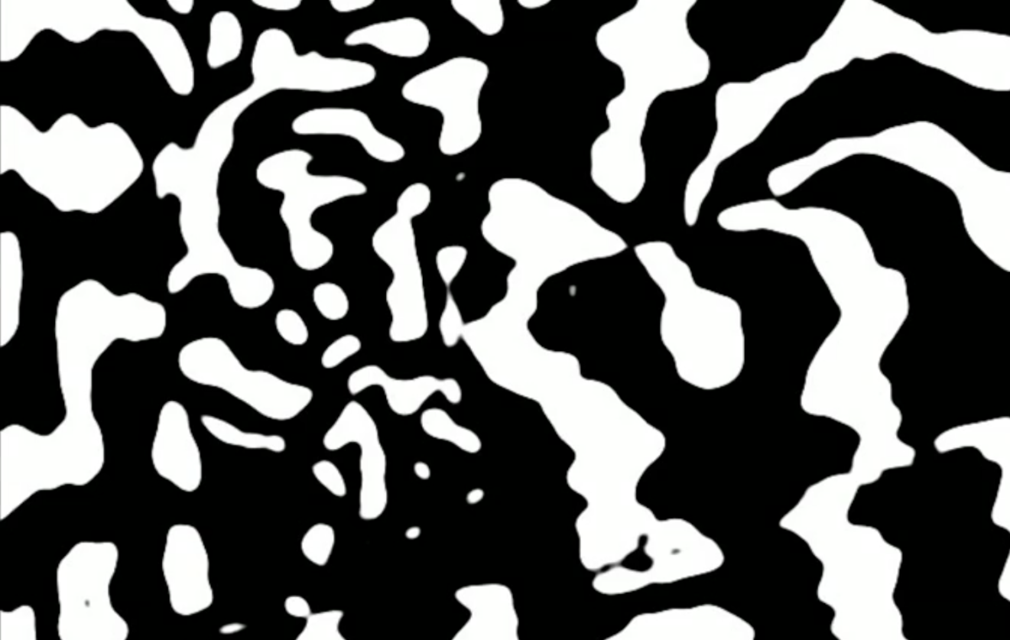

Slide 14
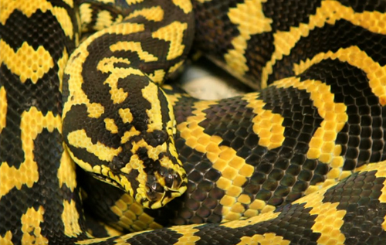

Slide 16
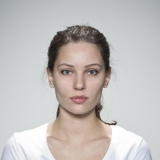
The Construction of Reality
Predictive Processing
Beliefs about Reality
“Photograph” vs. “AI-Generated”
Notes:
Best guess

Slide 17
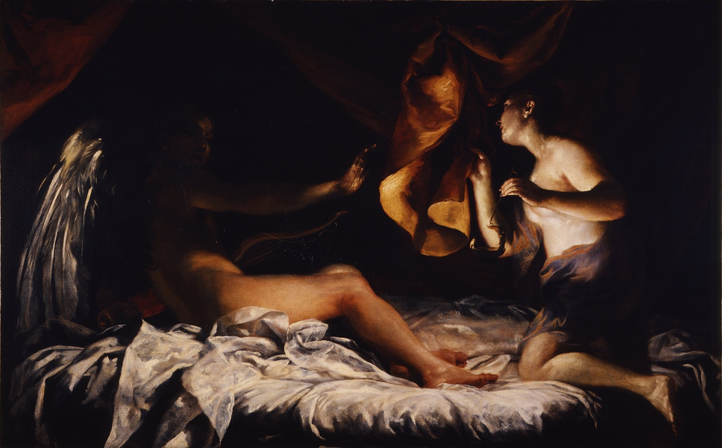
Synthetic Prejudice
“Anti-AI bias”
Amore e Psiche (Crespi, 1709)

Slide 18
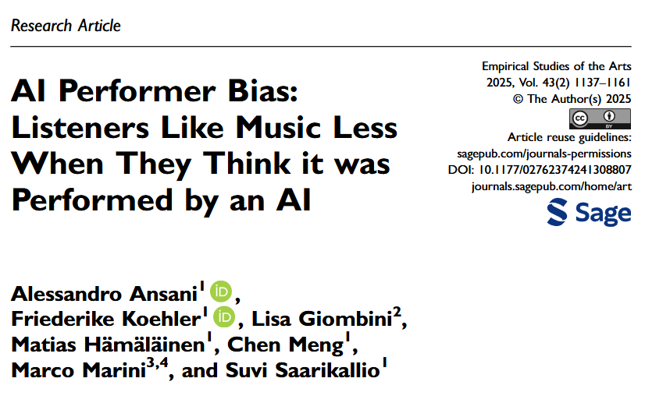
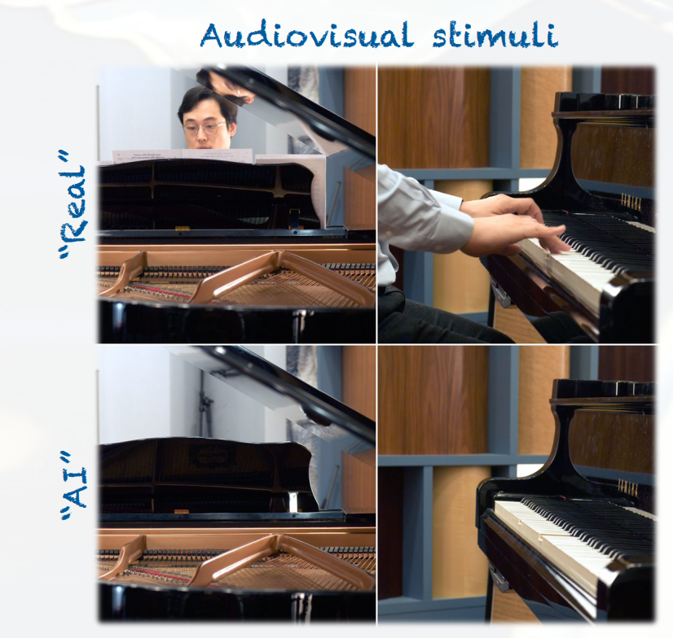
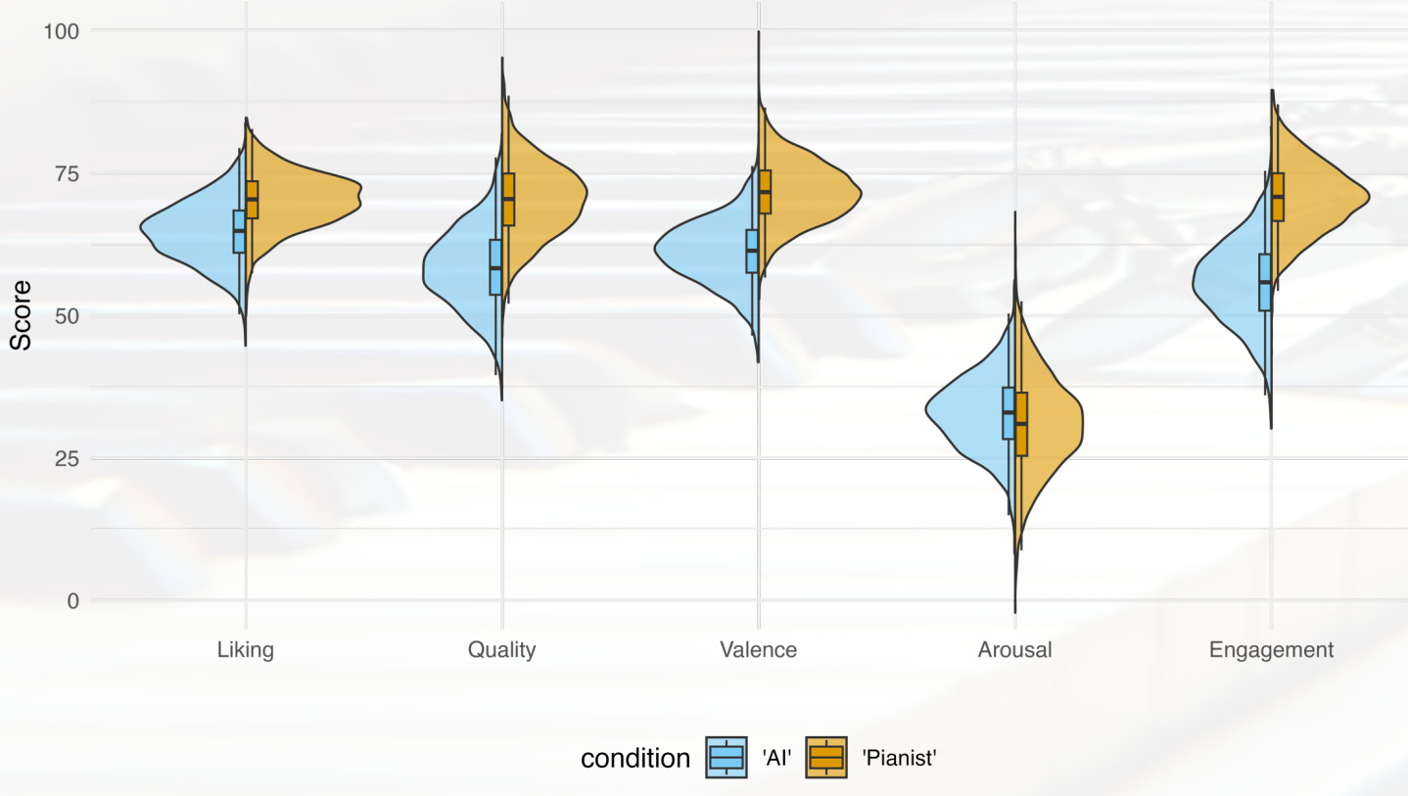
Synthetic Prejudice: Example 1
Less perceived positive characteristics for music believed to played by an AI (Ansani et al., 2025)

Slide 19
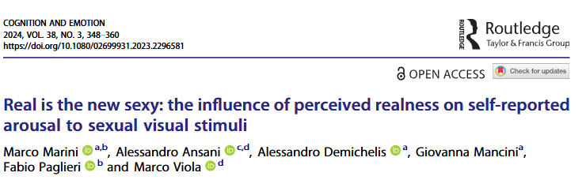
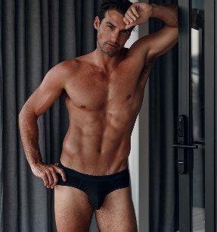
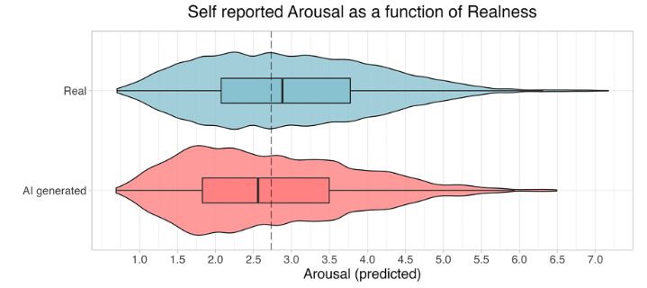
Synthetic Prejudice: Example 2
Less perceived arousal for erotic pictures believed to be AI-generated (Marini et al., 2024)
Real
AI-Generated

Slide 20
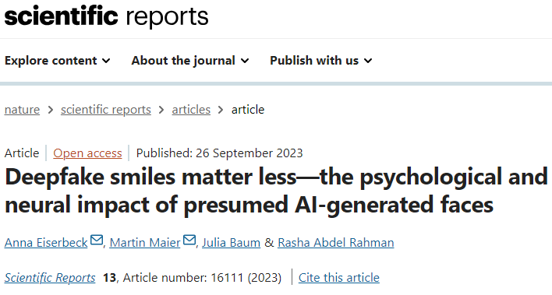
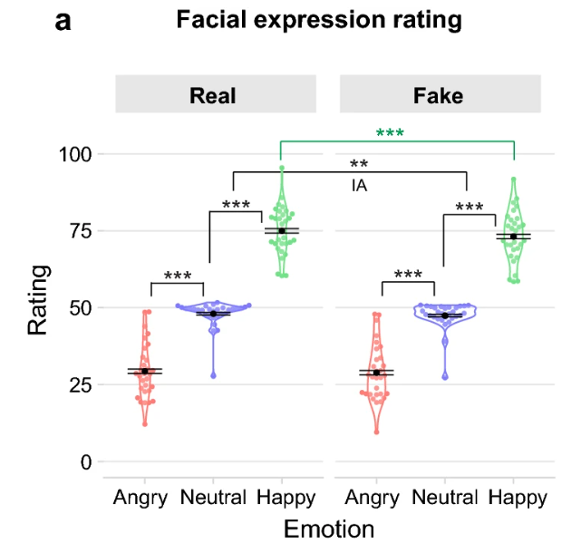
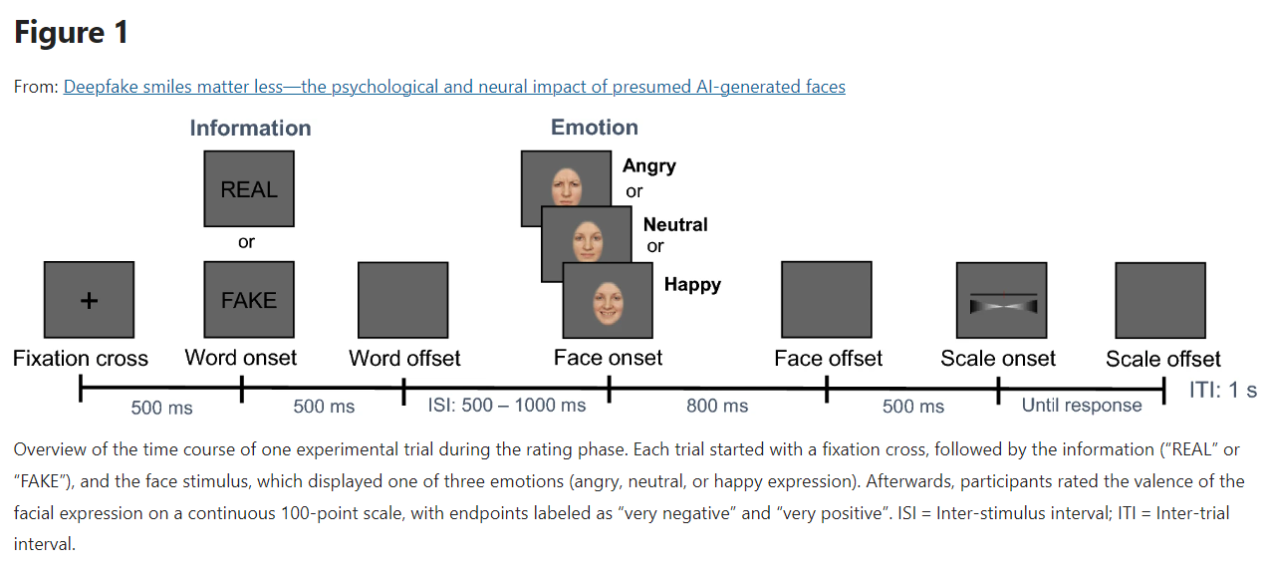
Synthetic Prejudice: Example 3
Less perceived positive emotion (smiles) when we believe that a face is AI-generated (Eiserbeck et al., 2023)

Slide 21
Our Study AI beliefs & Attractiveness

Slide 22
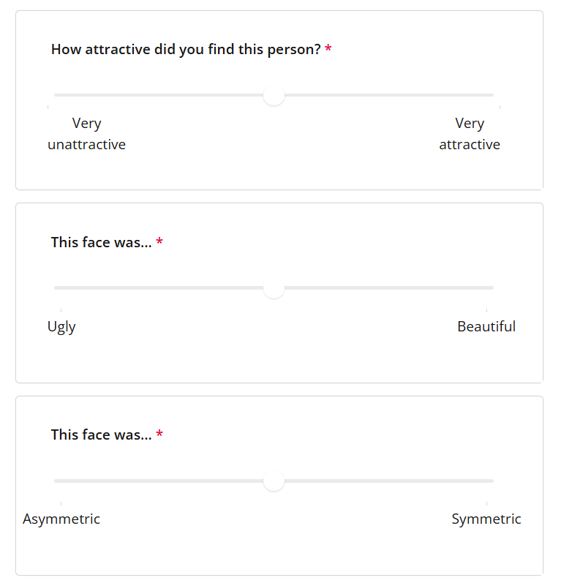
How about attractiveness?
Our study was designed to measure the effect of the « AI bias » (i.e., the effect of the condition) on Attractiveness
Research Fact
A common part of the research process is to separate the wheat from the chaff: identify in the experiment / data what is relevant and what is not for a specific question of interest

Slide 23
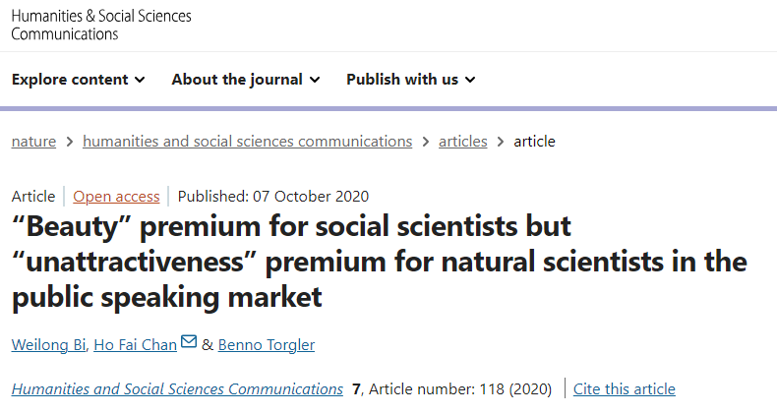
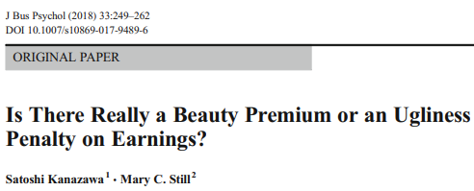
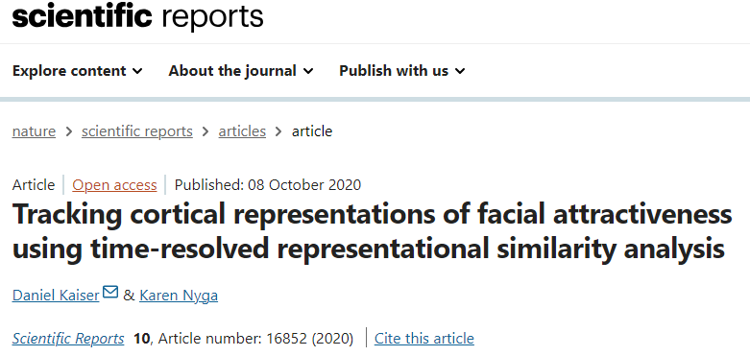
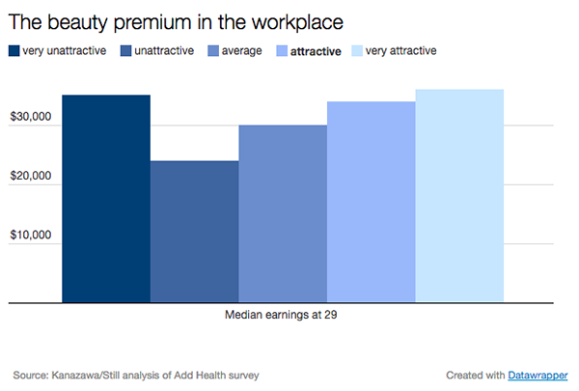


Why attractiveness?
One of the main facial evaluations
Automatic and unconscious appraisal
150–200 ms (Kaiser et al., 2020)
Evolutionary grounded
Massive effect in a large variety of domains
« Beauty premium »* (Kohler et al., 2025)
* Might be domain-dependent (Bi, 2020; Kanazawa, 2018)
Notes:
natural science: (e.g., physics, biology and medicine, N = 187)
social science [other]: (e.g., sociology, psychology, and political science, N = 189)
Respondents rated as “very unattractive” -- a portion representing just 1 to 2 percent of the total study sample of 20,000 people -- earned more than those rated just “unattractive,” and in some cases even more than people deemed attractive.

Slide 24






Attractiveness & Reality
Facial Attractiveness increases the likelihood of a face of being judged as real vs. AI-generated (Makowski et al., 2025)
Evaluation of Attractiveness
Beliefs of Reality
TRICK
Notes:
Attractiveness: trivial?
Why all stimuli real?

Slide 25

Effect of reality beliefs on Attractiveness
Evaluation of Attractiveness
Beliefs of Reality
It is fair to assume that having a prior belief that a face is AI-generated might impact its evaluation of attractiveness
We can induce beliefs about the stimuli to test that using a within-participant experimental design with 2 conditions (« AI-Generated » vs. « Photograph ») assigned randomly to real faces
Hypothesis?
Faces seen in the « AI » condition will be rated as less attractive than in the « Photograph » condition
Consistent with a « Synthetic Prejudice » (anti-AI bias)

Slide 26


All real faces?
Having « actual » AI-generated content introduces a perceptual confound, which might compromise the belief in the instruction.
We are interested in the effect of the belief, and not in the quality or characteristics of a particular AI-generating model. We are interested in beliefs assuming a perfect AI-generated algorithm.
Evidences suggests that modern AI models generate faces indistinguishable from real photographs (Nightingale & Farid, 2022; Tucciarelli et al., 2022)
Notes:
Perceptual confound

Slide 27
Effect of Condition on Attractiveness
How to operationalize the « Anti-AI » bias?
For each participant, we compute the mean attractiveness for faces seen in the « Photograph » condition, and the mean attractiveness for faces seen in the « AI » condition
AttractivenessBias = MeanAttrac_Real – MeanAttrac_AI
There is likely inter-individual variability in the effect
100%
Participant n°1
100%
Participant n°2
100%
Participant n°3
GOAL
The goal of this study is to investigate if certain dispositional traits (attitudes towards AI or misinformation susceptibility) predict the AI-bias on Attractiveness
Attractiveness
Attractiveness
Attractiveness
0%
0%
0%
Photograph
AI
Photograph
AI
Photograph
AI

Slide 28
Methods

Slide 29


Procedure
« « you will see real photographs and AI-generated faces with preceeding labels indicating which is which »
Phase 1
N = 345
Consent Form
Demographic information
Questionnaire 1
« « actually, the labels were mixed-up: you need to try to identify if the face is real or not »
Phase 2
Cover Story 1
Not used for the report
Experimental Task
Phase 1
Questionnaire 2
Cover Story 2
Dispositional Characteristics (« Traits »)
Experimental Task
Phase 2
BAIT
Beliefs about AI Technology
MIST
Misinformation Susceptibility Test
BRS
Bullshit Receptivity Scale
Questionnaire 3
Debriefing
Notes:
Is this a within participant or a between participant design? Mixed design study (within + between)

Slide 30



Measures
AttractivenessBias
Obtained from the experimental task for each participant
AttractivenessBias = MeanAttrac_Real – MeanAttrac_AI
Score between -1 and 1
Higher (positive) score = real faces rated more attractive than AI faces
= Stronger Anti-AI bias
BAIT
Beliefs about AI Technology (Makowski et al., 2025)
14 items
7 phrased positively (“Current AI algorithms can generate very realistic images”)
7 phrased negatively (“Images of faces or people generated by AI always contain errors and artifacts”)
Reverse negative items
Average all items together
Score between 0 and 5
Higher BAIT score = more positive attitude & expectation about AI technology
MIST
Misinformation Susceptibility Test
(Maertens et al., 2024)
8 items short version
4 real news (“Attitudes Toward EU Are Largely Positive, Both Within Europe and Outside It”)
4 fake news (“Certain Vaccines Are Loaded with Dangerous Chemicals and Toxins”)
Compute the proportion of items (N / 8) believed to be False
Score between 0 and 1
Higher MIST score = more likely to believe news to be fake. Measure of distrust.
BRS
Bullshit Receptivity Scale
(Pennycook et al., 2015)
20 items
10 “pseudo-profound bullshit” items (“Hidden meaning transforms unparalleled abstract beauty”)
10 prototypically-profound control items (“Your teacher can open the door, but you must enter by yourself”)
Average profundity ratings of the first 10 items
Score between 1 and 5
Higher BRS score = stronger tendency to find bullshit statement profound
+1 Attention check item
“I can show that I am Human and not an AI by answering all the way to the right”
AttentionCheck
Average of the 2 items
1 = both correct, 0.5 = one failed, 0 = both failed
+1 Attention check item
“Wholeness is found in simple choices, select all the way to the left to show you are paying attention”

Slide 31
Hypotheses
AttractivenessBias
Difference in attractiveness ratings between real and AI-generated
Expectations about AI technology
The more someone expects AI to look bad, the more they might rate AI images as less attractive (to align with their expectations)
Bullshit receptivity
The more someone believes in bullshit statements might be more easily « fooled » by the manipulation and engage with it uncritically, leading to a higher difference between real and AI faces
Distrust in the Manipulation
The more someone expects news and instructions to be false, the more they might consciously or unconsciously not believe in the manipulation (the labels), reducing the difference of attractiveness between real and AI
Measured by the BAIT
Measured by the BRS
Measured by the MIST

Slide 32
Lab Report
1. Describe the sample demographics
Note: there isn’t only one correct answer. Choices must be described and justified when possible.
2. Consider whether to exclude participants based on some criteria (demographic, outlying scores, attention checks, …)
Note: The final sample (after exclusion) also needs to be described.
Hypothesis
More positive expectations about AI capabilities would lead to less expected difference with faces believed to be real
Question n°1
Is the Attractiveness AI-Bias related to Attitudes towards AI?
Question n°2
Is the Attractiveness AI-Bias related to the tendency of believing news to be fake?
Hypothesis
The tendency to believe news as fake would lead to a stronger distrust in the manipulation and beliefs that all faces were real or AI, leading to a weaker difference between them
Hypothesis
The tendency to believe in bullshit statements would be associated with a stronger effect of the manipulation (more acceptance of the labels), leading to a stronger difference between them
3. Do the results change when we « adjust » for the tendency to believe in anything (pseudo-profound bullshit)
Note: You need to chose one question (i.e., one primary predictor) between the two
4. Report findings and discuss them

Slide 33

Lab Report
Tips for lab report
The lab report should follow the structure of an academic paper (abstract, introduction, methods, results, discussion)
You need to choose:
Whether to exclude participants (e.g., based on the attention check score or demographic categories)
One main predictor of interest: BAIT or MIST
Analysis
Remember the process of E.V.I.L.
The specifics will be provided on canvas, and in the Week 4 skills lab

Slide 34
Summary

Slide 35


Key Points
Processing & judging the « reality » of things is becoming a prevalent activity
It is important to understand the psychological consequences of believing that things are real vs. not-real
Scientific literature suggests the existence of an « anti-AI bias »: things believed to be AI-generated are judged less positively
We ran an experiment to measure the anti-AI bias for facial attractiveness ratings
We are interested in explaining the inter-individual variability in the anti-AI bias on attractiveness with « attitutes towards AI technology » and « distrust in news »

Slide 36

Thank you
Dominique Makowski
D.Makowski@sussex.ac.uk

Slide 37
JUNK

Slide 38
Determinants of Reality Beliefs

Slide 39

Reality judgments of faces
What mechanisms might be at stake when judging whether a face is real or AI-generated?
External information
Image resolution, details, physical characteristics
Contextual information
Prior(s) about odds? {0.5, 0.5}, {0, 0}, {1, 1}
Internal information
“Gut feeling”, automatic face appraisals (attractiveness, familiarity, symmetry, …)
Dispositional characteristics
Personality, knowledge, attitudes…

Slide 40


What influences reality beliefs?
Evaluation of Attractiveness
Evaluation of Reality
Personality
?
Misinformation susceptibility
Outstanding question:
Do people that rated more faces as « real » also rate more fake news as « real »?
Makowski et al., (2025)

Slide 41
Condition
AI-Generated
Stimulus
London Set (Debruine, 2021)
Appraisals
Analog scales
+
Photograph
+
Attractiveness
Beauty
Symmetry
x 36
0.5 s
1 s
0.5 s
0.75 - 3.75 s
+
Artificiality
AI-Generated ----x------------ Photograph
x 36
0.5 s
1.5 s

Slide 42

Paradigm – Ratings FakeFace3
PHASE 1
PHASE 2

